Slide 1
Lesson 6: RNN
Time series predictions made easy

Slide 2
Introduction
RNN Overview
LSTMs
Backpropagation through Time
Building a RNN in keras

Slide 3
What is an RNN?
Memory allows the Neural Network to keep track of long-term dependencies such as quotes used in writing.
Memory
Long-Term Dependency
Stateful Representation
Variable length
Variable
length
Long-term dependency
Stateful representation
Memory

Slide 4
A visual Representation: Basic NN
Matrix
of
activations
Output: batch_Size * Number of classes
Matrix Product: Softmax
Hidden: batch_size * Number of activations
Matrix Product: Relu
Input: batch_Size * number of inputs

Slide 5
A visual Representation: Unrolled Recurrent Neural Network
Information carries over through time via the hidden states
This length of time which the hidden state carries over can be set by a person
T - 1
T = 0
T + 1
Each grouping represents a time in the sequence

Slide 6
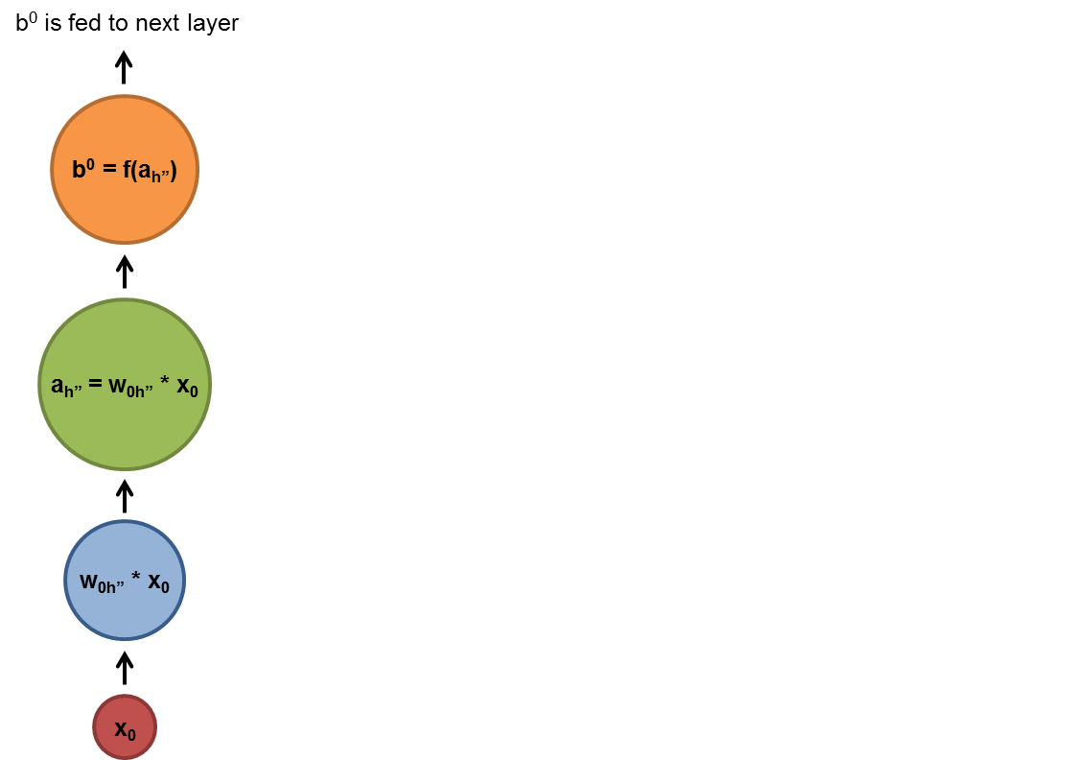
A visual Representation: RNN diagram
X is the input
W is the weight
A is the activation
B is the output
1: X gets transformed by W
2: X is then fed to A
3: B sent to the next layer
4: B is also transformed by a W
5: The transformed output from the last time step is fed into the next activation

Slide 7
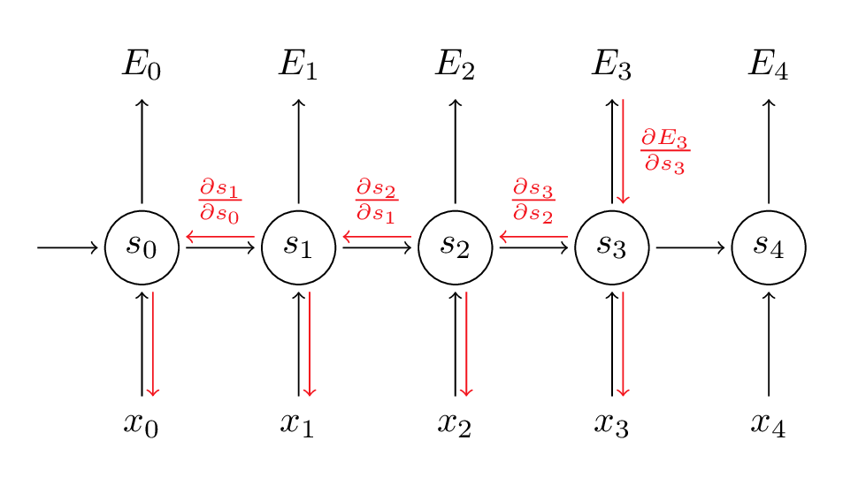
Backpropagation Through Time (BPTT)
Backpropagation through time is an algorithm used to train Recurrent Neural Networks. RNNs are stateful and so you need to update the weights and activations for the entire time period desired.

Slide 8
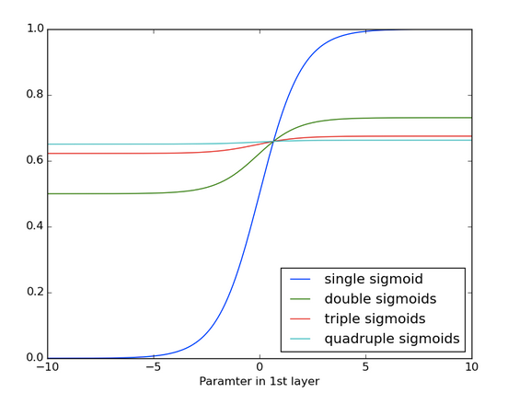
Vanishing and exploding Gradients
RNNs take in parameters from many time steps. It's difficult to know how much importance to give to different inputs
Inputs relate to each other via multiplication. Derivatives are vulnerable to vanishing and exploding
Check the effects on the sigmoid function on the left. After applying it 4 times it becomes very difficult to decern any slope at all.
This is Vanishing Gradient

Slide 9
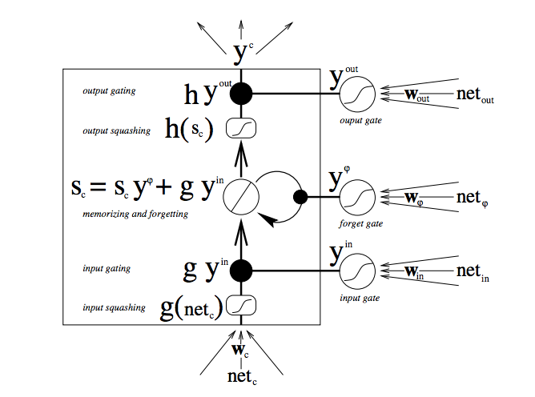
Long Short Term Memory
This is the LSTM or Long Short Term Memory. This is the backbone for modern RNN implementations.
LSTM is a logical gate that can store, delete, and send information from previous time steps.

Slide 10
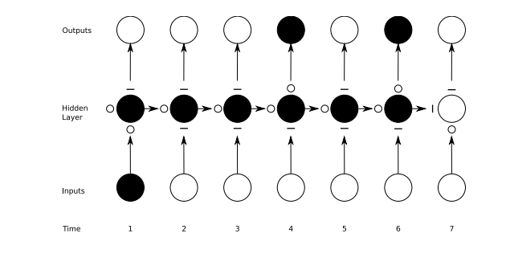
Toy Example

Slide 11
Keras Implementation

Slide 12
Beijing AQI Prediction
WHY RNN?
Pollution levels in Beijing are measured in AQI(Air Quality Index). There are city wide measurements every 1 hour.
This is a Time series problem that is well suited for RNNs. We will use Keras to build an RNN to predict AQI levels in the future based on measurements from the past
Assumptions
We are assuming that weather plays a large role in determining AQI
Along with weather we are assuming that day of time matters a lot because of traffic patterns in beijing

Slide 13
To jupyter Hub

Slide 14
Stateful Vs Non-stateful
Stateful
When you set an RNN to be stateful you are telling the RNN that it should take into account the values of a set time frame in the past before it makes a prediction
Use Stateful is an input is a single time step. Then chose your batch appropriately
Non-stateful
After a Batch of inputs the hidden states are reinitialized to 0
Use Stateless if your input is a time series already

Slide 15
Single Layer vs Multiple Layer
Single Layer
A single layer with nonlinear activations can approximate very dynamic systems. However it is limited because of the single layer
Multiple Layers
With multiple layers you get into deep learning territory The non-linear activations stacked on each other greatly expand the capacity of the neural network to learn extremely complex dynamics

Slide 16
Normalization
Stateful
Batch normalization is returning the data to a mean 0 state like we usually do to the data before we start training the networks.
But this is applied at the level you use it on.
Non-stateful
When you use drop out you are taking a random percentage of the neurons in a layer and deactivating them. This causes the network to become more generalized and less prone to overfitting.

Slide 17
Results

Slide 18

Thanks!
Contact Information:
cdossman91@gmail.com

